Slide 1

Bryan Tang | Casey Juergens | Vincent Lu
Notes:
vincent

Slide 2
Hypothesis
Are pokemon with the highest stats the hardest to catch?
Notes:
vincent

Slide 3
Hypotheses
Are pokemon with the highest stats the hardest to catch?
Alternative Hypothesis: If a pokemon’s stats and capture rate are related, then the capture rate will decrease as the pokemon’s stats increase.
Null Hypothesis: If a pokemon’s stats and capture rate are not related, then the pokemon’s stats will have no effect on the capture rate.
Notes:
vincent

Slide 4

Questions we asked ourselves
How do we define capture? How do we define highest stats? Are some stats more important than others?
Each pokemon has a long list of stats, which vary by type, skill level, and individual pokemon . These stats include categories like stamina, defense, attack, and combat power.
Sometimes in Pokemon Go all you can find are low-level normal type pokemon like zubats, can pokemon spawning cycles and rarity skew our results at all?
Notes:
Casey
If we want to look into how hard it is to catch certain type of pokemon, we first need to figure out how to define “hard to catch”. Can you only find specific types of pokemons in certain areas/cities?
Are some stats more important than others? Each pokemon has a long list of stats- varying by type, skill level, and individual pokemon. These stats include categories like stamina, defense, attack, and “CP” or combat power (which is the aggregate of all the stats).
Sometimes in Pokemon Go all you can find are the same general pokemon- zubats, rattatas, magikarps, pikachu. Will spawning cycles, pokemon availability, rarity affect our results at all?

Slide 5

Data exploration
We searched kaggle and data world for various data sets, and found two relevant ones we liked.
Our first csv file listed the stamina, attack, defense, combat power, capture rate, flee rate, and pokemon type for each individual pokemon.
Our second csv file listed almost 90,000 entries of pokemon and their spawn locations in the Bay Area, specifically with their coordinates.
Notes:
Casey
We search google and kaggle first to find interesting Pokemon Go Data sets. We found quite a few data sets that gave info about pokemon and maybe a little about stats, but not that we really liked or felt inspired by. We finally found one off of Kaggle, and one a site called “data-world”. This first one is fantastic- super descriptive on how it sourced it data, and even gave us columns based on “capture rate” and “spawn rate”.
The second one we found was focused more on actual spawning data in San Francisco, with almost 90k entries of just pokemon with their latitude and longitude.

Slide 6

Notes:
Casey
Here’s our first dataset that we found on data-world.com. The data set publisher states that they found most of their data from reddit threads and Kaggle datasets. They specifically sourced from the “The Silph Road” subreddit, where redditor are trying to determine themselves the possible calculations for stats and capture rates, because Niantic and Nintendo keep their code pretty well secure. There definitely is some assumptions made and possible human error. The catch and flee rates were sourced directly from a specific redditor named “The Desert Rain” who had put serious time and effort into calculating the capture rate.
It lists out the first generation of pokemon, 146 individual pokemon, and their average: stamina, attack, defense, capture rate, flee rate, spawn chance, combat power, as well as their pokemon type.
We really enjoyed how descriptive the data set publisher was on how they sourced their data, and the fact that it had spawn, catch, and flee rates calculated.

Slide 7
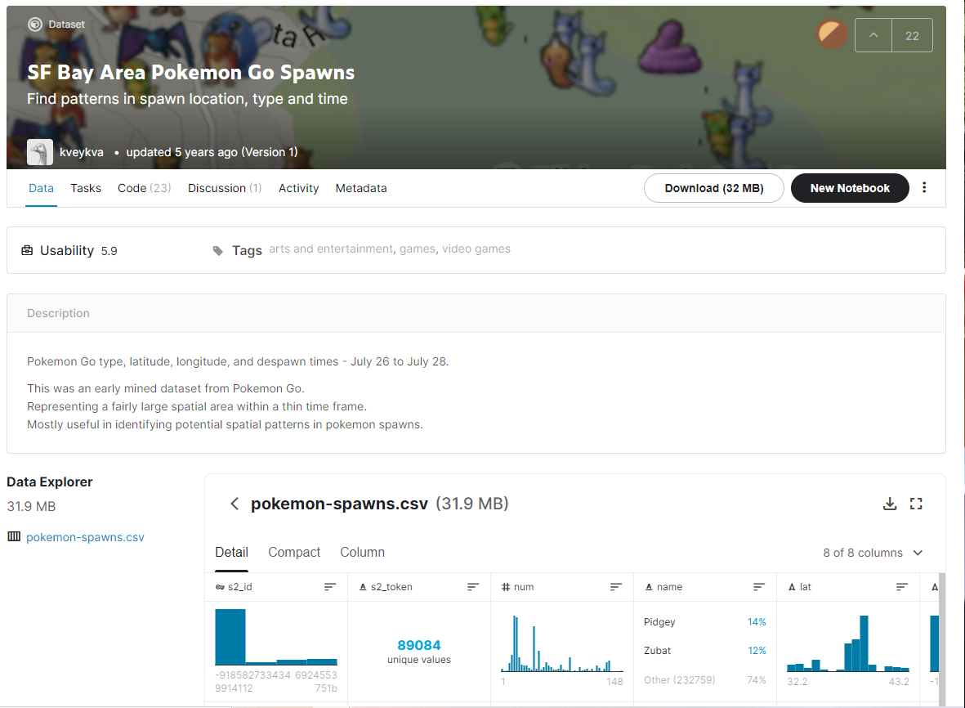

Notes:
Casey
This second data set wasn’t nearly as descriptive as the previous one. The author pulled the pokemon type, latitude and longitude, and despawn times of the pokemon found in the bay area between July 26 to July 28 in 2016. It has 89 thousand entries of pokemons that spawned in those 2 days. It mostly was comprised of pidgeys, zubats, rattatas.
We found this data set a little intimidating, and decided to clean out any possible duplicates, and merge it with the first data set. We were definitely interested in trying to see some real world pokemon go data- which pokemon were often seen, what stats actually showed, and their precise coordinates. I wish we could see more of the data sourcing process like we did in the first data set, but it really inspired us to see actual location data, and we really wanted to have some fun making maps.

Slide 8
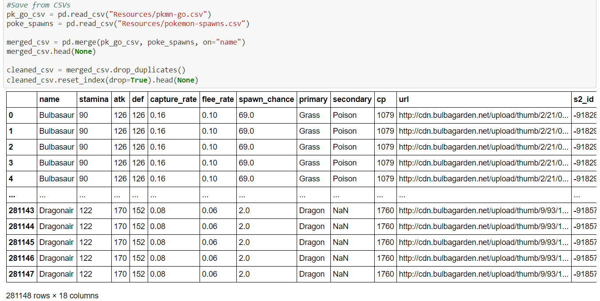
The Clean Up Process
Merge both datasets by name, and drop irrelevant columns
Remove exact duplicates of data to reduce datasize and improve accuracy of sampling.
In an effort to filter to data even further, we plotted some graphs to show correlations of stats to capture rate so we could show more clearly where players could find ‘rare’ Pokemon.
Notes:
Bryan

Slide 9
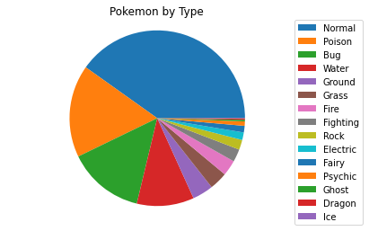
Pokemon Types
A little over 2/3rds of our data set is solely comprised of Normal, Poison, Bug, and Water types.
Notes:
Casey
Here’s the distribution of pokemon types from the merged data set.
I took the “types” and “counts” column from our merged dataset, and did a value_counts to list function to make this pie chart.
About 40% of the pokemon are normal type, while poison, bug, and water, take up about about a third. The other 9 categories take up the remainder of the set. Roughly ¼ of all the actual pokemon entries are zubats and pidgeys, both normal type pokemon.

Slide 10
Is there a relationship between stats and capture rate?
Notes:
Casey

Slide 11
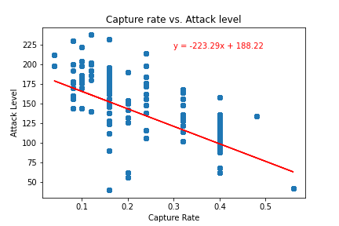

Capture Rate vs. Attack Level
We found a strong negative correlation between higher attack level and higher capture rate. This strongly supports our hypothesis that higher stats leads to lower capture rate.
The r-squared value is: -0.6266260700729032
The pokemon with a highest capture rate (56%) is a magikarp.
Notes:
Casey
So first thing I wanted to take a look at was the relationship between the capture rate we found in the first data set and the “attack level” of each pokemon.
I created a scatter plot based on our cleaned and merged data file, with the “capture” column and the “attack” column.
I Also performed a linear regression to precisely determine the correlation. Just like we proposed in our hypothesis- the higher “attack level” a pokemon has, the harder it was to catch. Almost all the pokemon with a capture rate of 30% had an attack level of 125 (out of 225) or greater. It has a pretty definite negative correlation, with an r-squared value at -.6266260…
I would like to note an interesting outlier- the one in the bottom right hand corner of the graph at a .56 capture rate. After a little digging, I found out that this was the “magikarp” pokemon. Now I don’t know if any of you all played or know anything about pokemon, but magikarp is known to be really easy to catch because it doesn’t know any attack moves. This all perfectly supports our hypothesis.

Slide 12
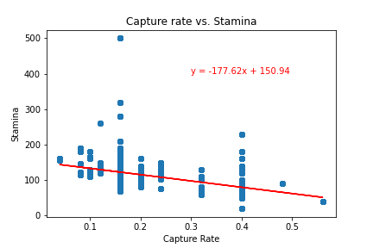

Capture Rate vs. Stamina
There seems to be a small, but notable, negative correlation between stamina and and capture rate.
The r-squared value is: -0.4863638544217492
There is an interesting outlier with 500 stamina and a capture rate of .16. This happens to be a Chansey, which is a normal type pokemon.
Notes:
Casey
The second stat I wanted to look at was capture rate vs stamina.
I created a scatter plot based on our cleaned and merged data file, with the “capture” column and the “stamina” column.
There was a small negative correlation between pokemon stamina and capture rate. The r-squared value is -.48636… I think it can be a little difficult to visualize the correlation because most of the data is grouped below the 200 stamina line.
I believe it supports our hypothesis minorly. We discovered another interesting outlier was a pokemon with 500 stamina- almost double most other pokemon- which I believed skewed the data and made the graph less readable. With such a crazy high stamina level and a capture rate of 16%, “Chansey” definitely supports our hypothesis, but makes creates a kink in our data visualization.

Slide 13
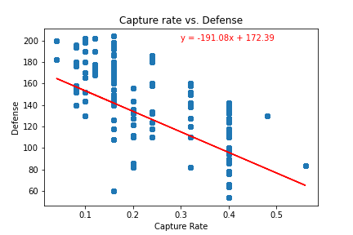
Capture Rate vs. Defense
We found a strong negative correlation between higher defense level and higher capture rate.
The r-squared value is: -0.5835128937875973
This is very similar to the graph we saw in capture rate vs defense as well, and very definitively supports our hypothesis.
Notes:
Casey
I created a scatter plot based on our cleaned and merged data file, with the “capture” column and the “defense” column.
We found a pretty significant correlation in capture rate v defense stats, with an r-squared value of .5835.
As we can see in the graph, most pokemon with a capture rate of 20% or less had defense levels at 120 (out of 200) or higher. The higher the defense stat, the lower the capture rate.
This strongly supports our hypothesis that higher stats are harder to catch.

Slide 14
Does Pokemon Type Relate to Capture Rate?
Notes:
vincent

Slide 15
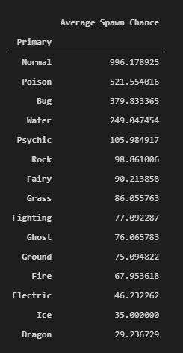
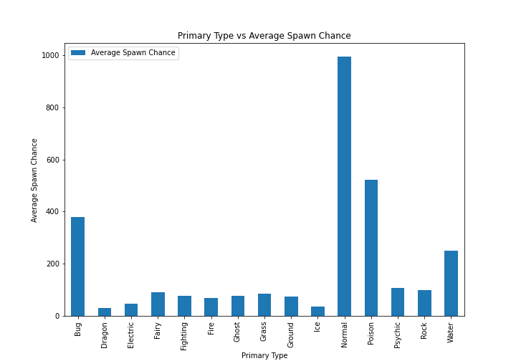

Primary Type vs Average Spawn Chance
Normal type pokemon had the highest spawn chance. This makes sense because they were a majority of the pokemon (40%) compared to total pokemon.
Dragon type pokemon were the rarest. This may be because there are only 2 dragon types that appear in the wild.
Notes:
vincent

Slide 16
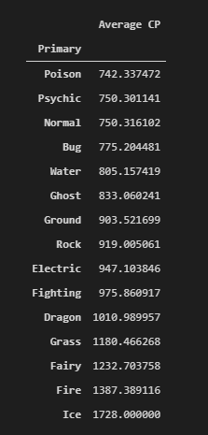
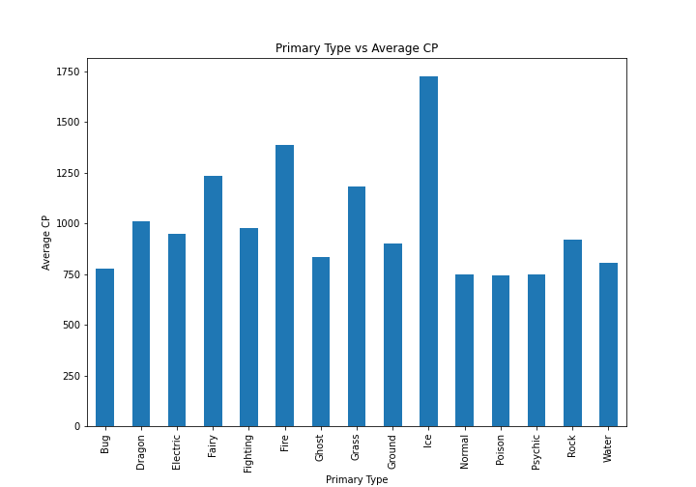

Primary Type vs Average CP
Ice type pokemon had the highest average CP, and poison type had the lowest.
With our hypothesis, this dataset should show that Ice pokemon are the hardest to catch, while poison types are the easiest to catch.
Notes:
vincent

Slide 17
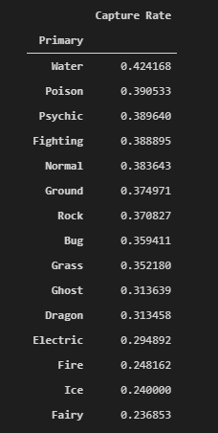
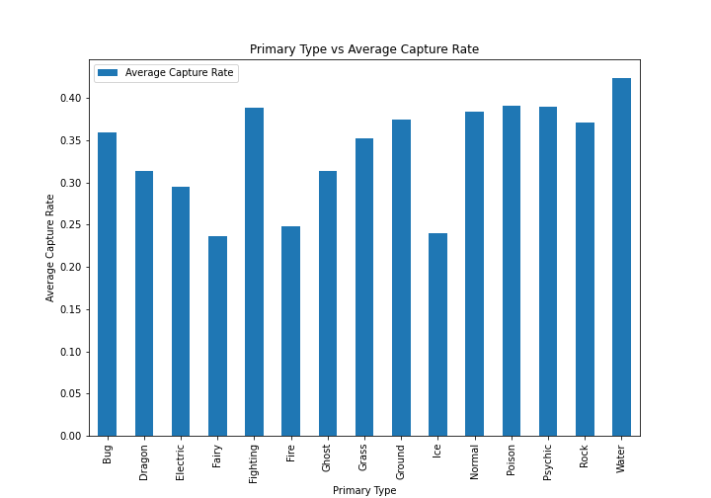

Primary Type vs Average Capture Rate
However, water type pokemon had the highest capture rate and fairy type pokemon had the lowest.
Data for water types may be skewed because water types receive an environmental bonus. They are more likely to appear near bodies of water.
Interesting to note that fairy types have the lowest capture rate despite being 3rd from last in terms of average CP.
Notes:
vincent

Slide 18
Is there a relationship between GeoData and Combat Power?
Notes:
bryan

Slide 19
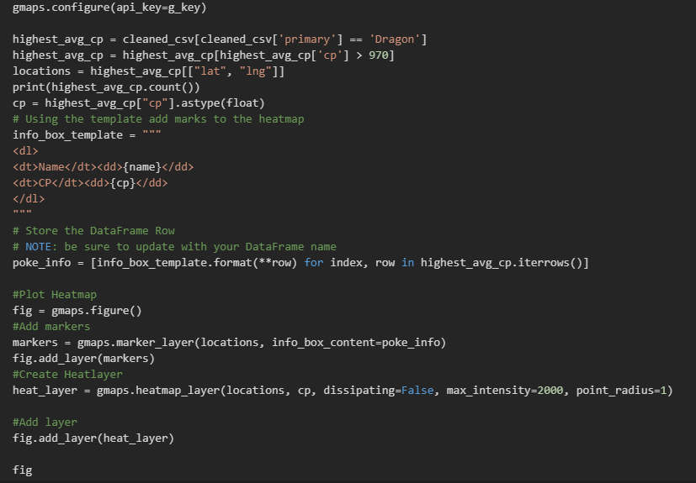
Notes:
Here I loaded the geodata into gmaps to create

Slide 20
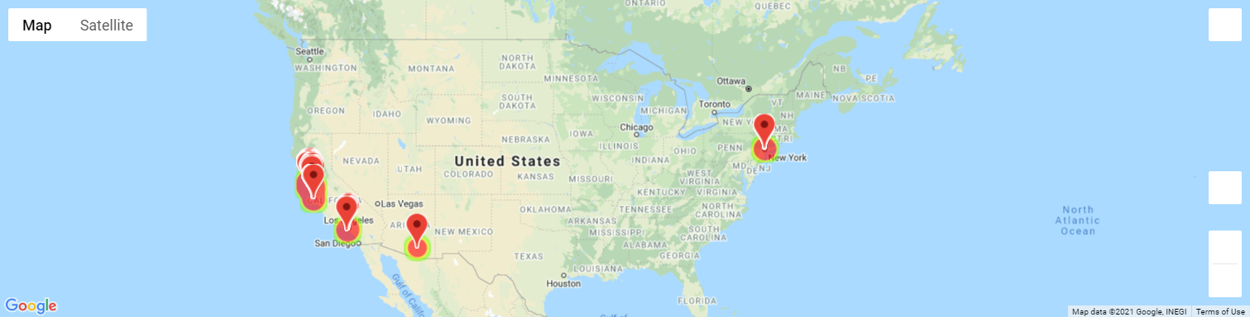

Slide 21
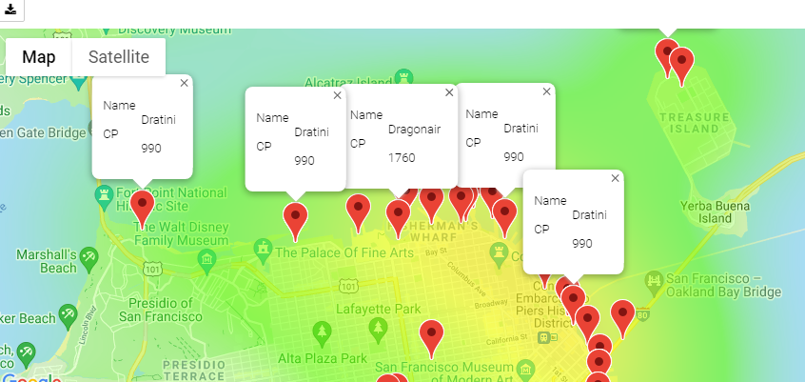
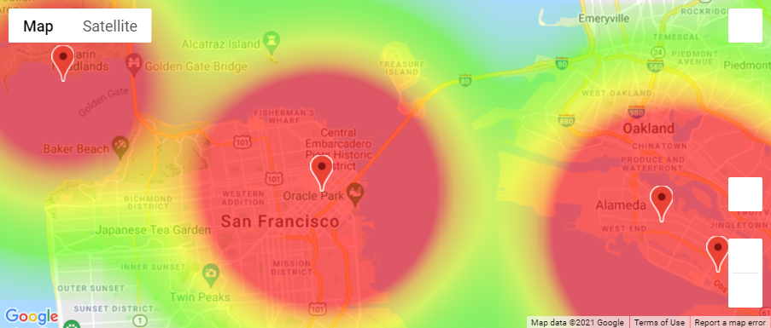
GMAPS API Visualization of Distribution vs GeoLocation
Our map shows that even though Dragon-type pokemon have the lowest spawn chance and are less than one percent of the total population, they appear to occur frequently due to geographic bonuses compared to other Types with similar spawn chance/capture rates such as Ice and Electric Types.
Distribution of Dragon Type Pokemon
Distribution of Ice Type Pokemon
Notes:
bryan
After I found that the 2nd dataset had geodata, I called them into the gmaps api to chart their physical spawn locations in places with high populations, aka large amounts of players.

Slide 22
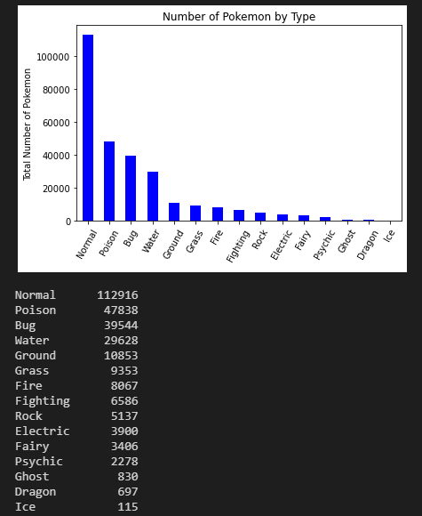
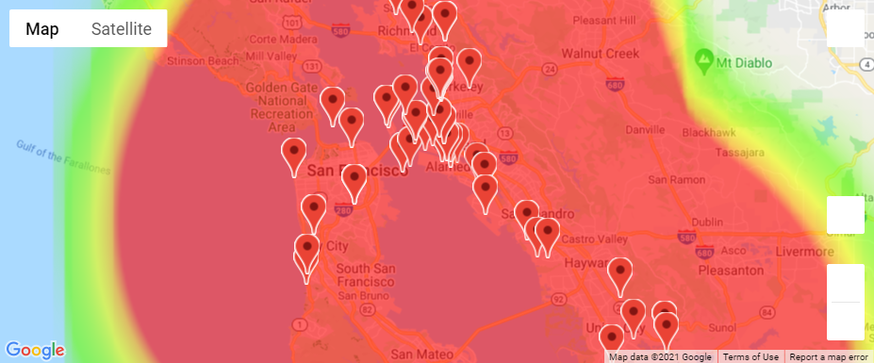
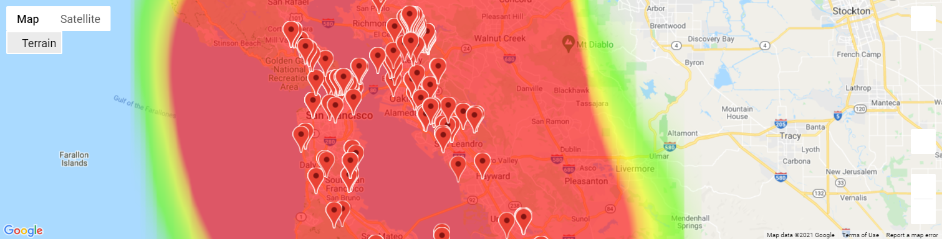
Is the distribution of combat power(aggregate stat value), mostly influenced by species populated by environmental factors?
Comparison of Distribution of Electric with CP > 970 vs Dragon Type
Distribution of Species by Type
Notes:
Bryan As I was trying to create relevant maps from the Geodata, I had a lot of questions about the data. With how skewed the data is, it also makes sense that Types with less spawns overall, would have higher average stats.

Slide 23

Conclusions
Reject our hypothesis of higher stat pokemon are harder to catch.
To measure how difficult a pokemon was to catch, we measured spawn chance, average CP, and capture rate.
Capture rate seems to be heavily influenced by environmental bonuses, and the stats of a pokemon come second.
Notes:
vincent

Slide 24

Difficulties
-Troubleshooting github access, understanding branching, and managing workflow for merging commits.
-Verifying the integrity of data. Geodata found in cities located outside of the Bay Area is included in the dataset, bringing in a question of whether or not the data was actually mined correctly.
-Was this dataset too simple? Many of the pokemon types were comprised of only a few species, limiting the range of comparison.
Notes:
bryan* Discuss any difficulties that arose, and how you dealt with them * Discuss any additional questions that came up, but which you didn't have time to answer: What would you research next, if you had two more weeks?
Discuss the implications of your findings. This is where you get to have an open-ended discussion about what your findings "mean".

Slide 25
Further Analysis
Geodata for specific types in relation to Combat Power
Specific Geodata and stats analysis for individual species.
Distribution of species in specific areas
Chart relationship for stats across a specific species compared to capture rate

Slide 26

Any Questions?

